Slide 1


Detection of malaria in blood cells using convolution neural network
Project Group 21-CSP20
Guided By:
Dr. NALINI N
Designation: PROFESSOR
DEAN-STUDENTS' WELFARE
Presented by:
Anurag Nepal 1NT19CS036
Avishek Rijal 1NT19CS045
Baibhav Dhakal 1NT19CS048
Sabin Kandel 1NT19CS165

Slide 2
phase overview
(roadmap)
Phase 0: Dataset collection
Phase 1: Model Building and Training
Phase 2: Implementation of Webapp and Mobile app to detect malaria in real time
Phase 3: Final Integration & Module Testing

Slide 3
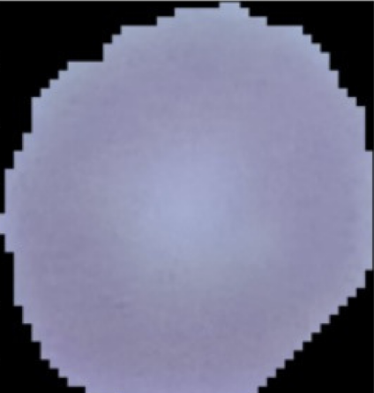
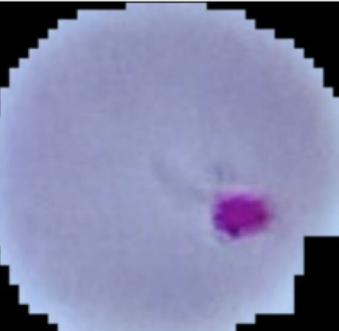
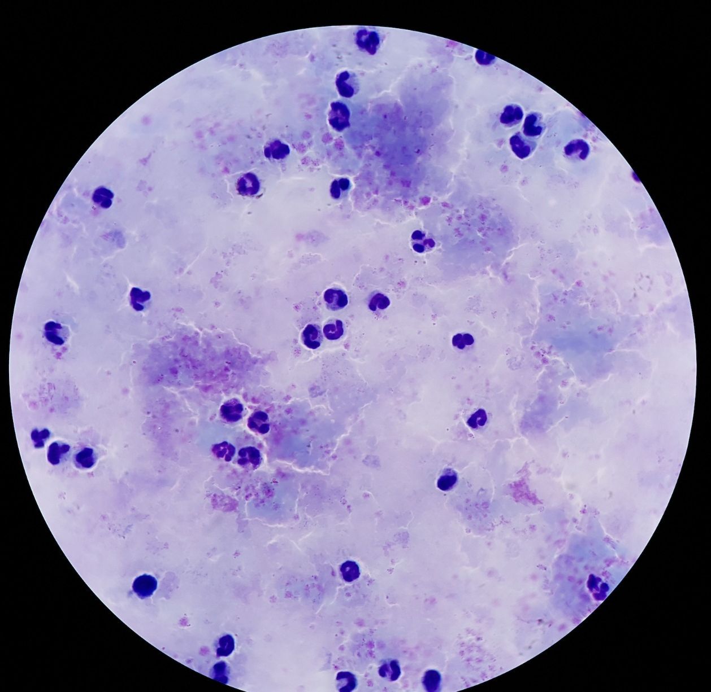
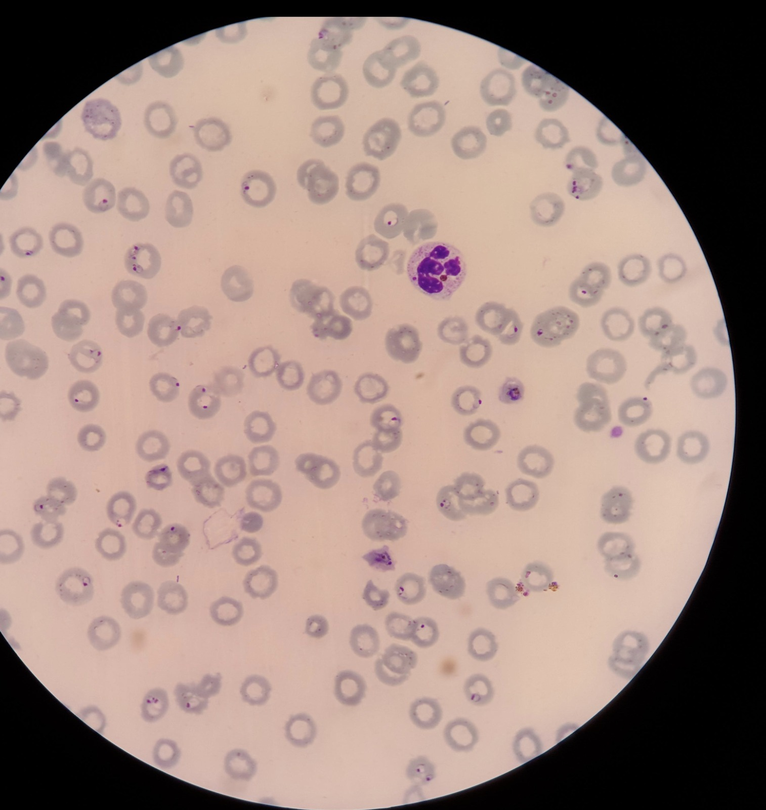
Dataset
Dataset taken from : Official National Institute of Health (NIH) website
The Dataset contains two folders:
Infected
Uninfected
And there are 27,558 images of blood smears with 50-50 distribution between infected and uninfected.
Additionally, we incorporated another dataset from the same source to include thick and thin smear blood cells to enhance our model and to detect real life cases more efficiently.
Infected Thick Smear Blood Sample
Uninfected Thick Smear Blood Sample
Uninfected Blood Sample
Infected Blood Sample

Slide 4
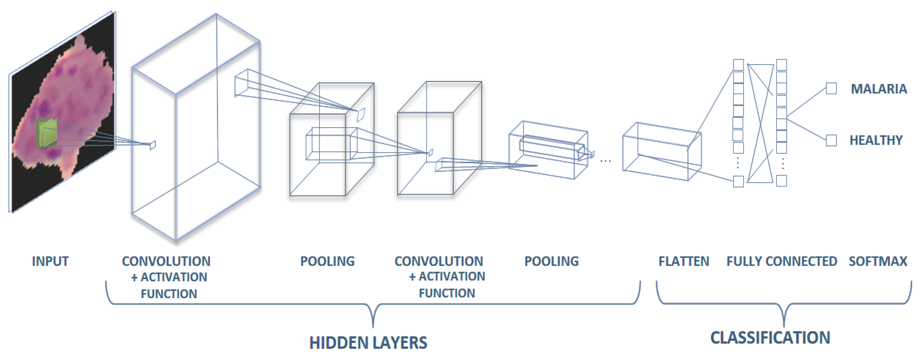
CNN Architecture

Slide 5
ABOUT CNN
CNN stands for Convolutional Neural Network, which is a type of deep learning algorithm primarily used for image recognition, object detection, and classification tasks.
The key building blocks of a CNN include input layer, convolutional layers, pooling layers, and fully connected layers.
  Input Layer: The input layer receives the raw input data, such as an image, and prepares it for further processing. In image-based tasks, this layer will typically be a set of 2D pixels arranged in a grid.
  Convolutional Layer: The convolutional layer applies filters to the input data in order to extract specific features. These filters are usually small squares or rectangles that slide over the input data, performing a mathematical operation (convolution) at each position.
  Pooling Layer: The pooling layer reduces the spatial dimensions of the output from the convolutional layer by summarizing each local neighborhood of the data. The most common type of pooling layer is the Max Pooling layer, which selects the maximum value within each neighborhood.
  Activation Layer: The activation layer applies a non-linear activation function to the output of the previous layer. This introduces non-linearity into the model and helps it learn more complex representations of the data.
  Fully-Connected Layer: The fully-connected layer takes the output from the previous layer and applies a linear transformation to produce a final output. This layer is typically used at the end of the CNN to classify or predict a label for the input data.

Slide 6
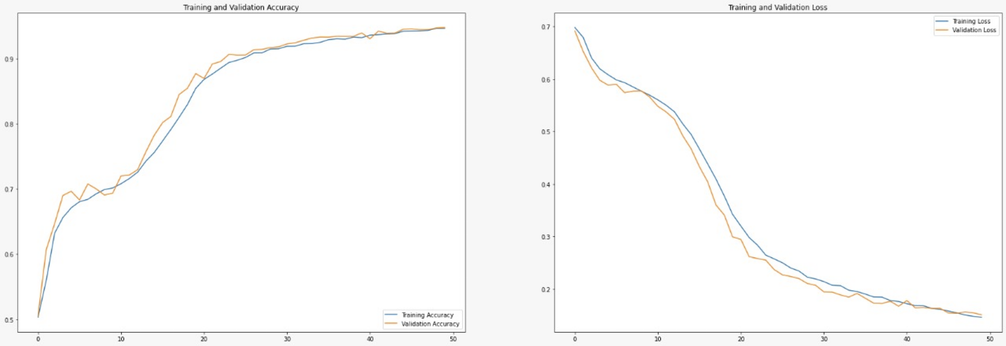
Evaluating our model
The output layer in the model are a Dense (2) layer i.e. the output is in the form of 2 output values
Probability of belonging to class 0 and probability of belonging to class 1.
So, there is less chance of the model getting confused whenever there are unknown test instances.
When the network gets confused the network will return the value with the higher probability so there is no erratic behavior during training and validation.

Slide 7
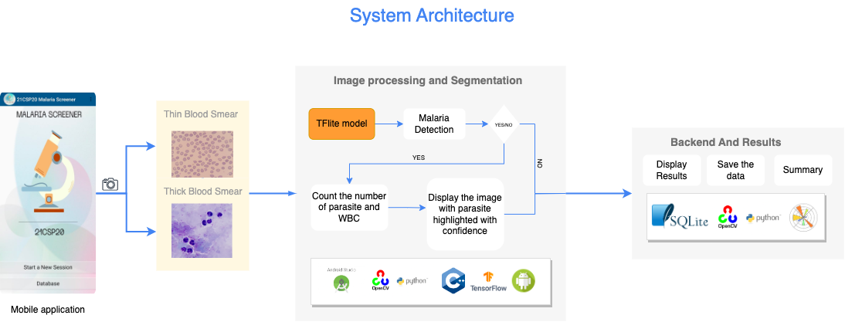
SYSTEM ARCHITECTURE
Detection of Malaria in Blood Cell Using Convolution Neural Network

Slide 8
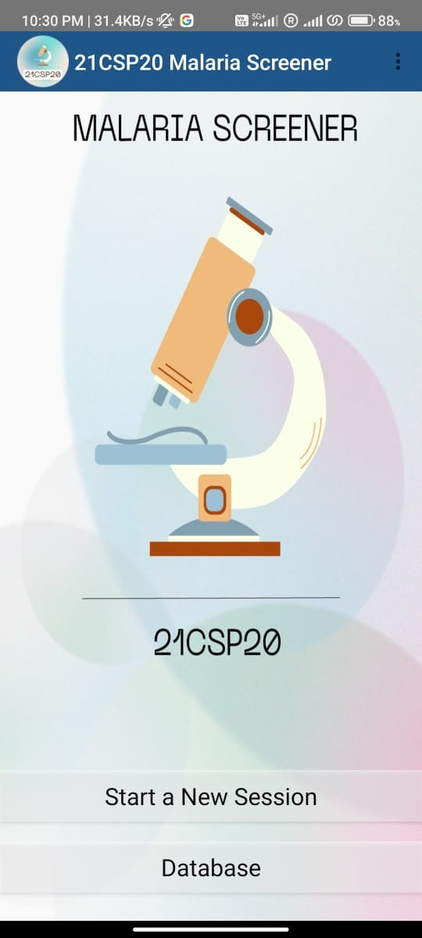
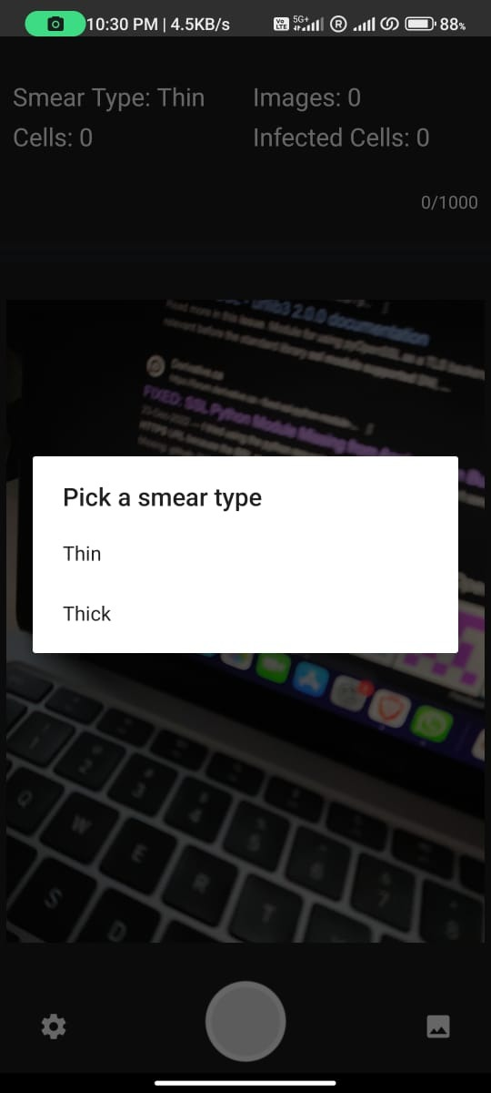
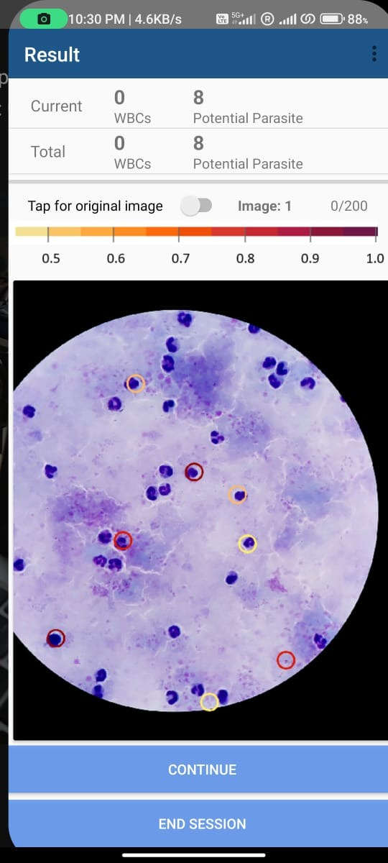
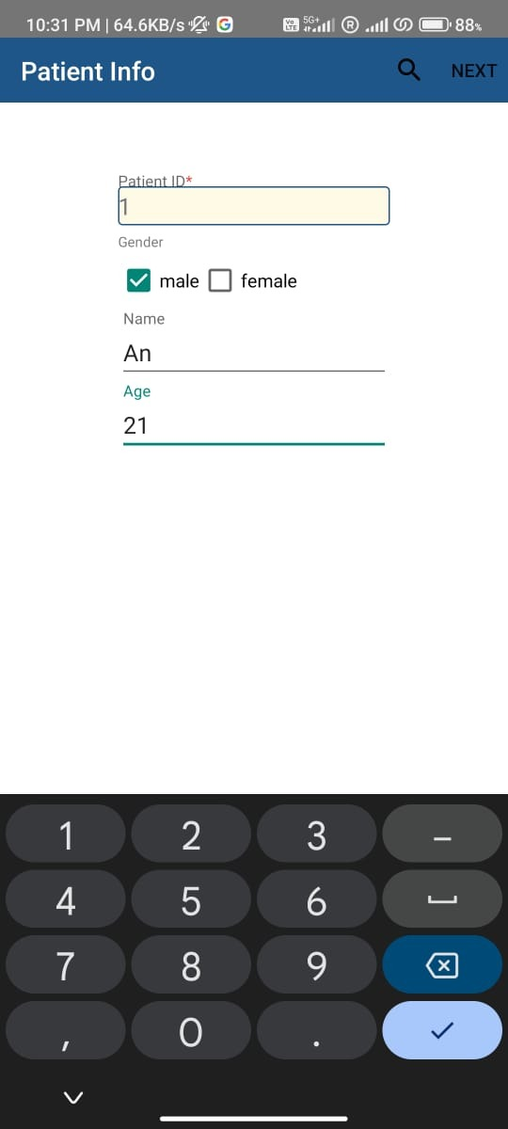
SCREENSHOTS
Welcome Page
Smear type
THICK SMEAR
RESULT
COLLECTING PATIENT INFORMATION

Slide 9
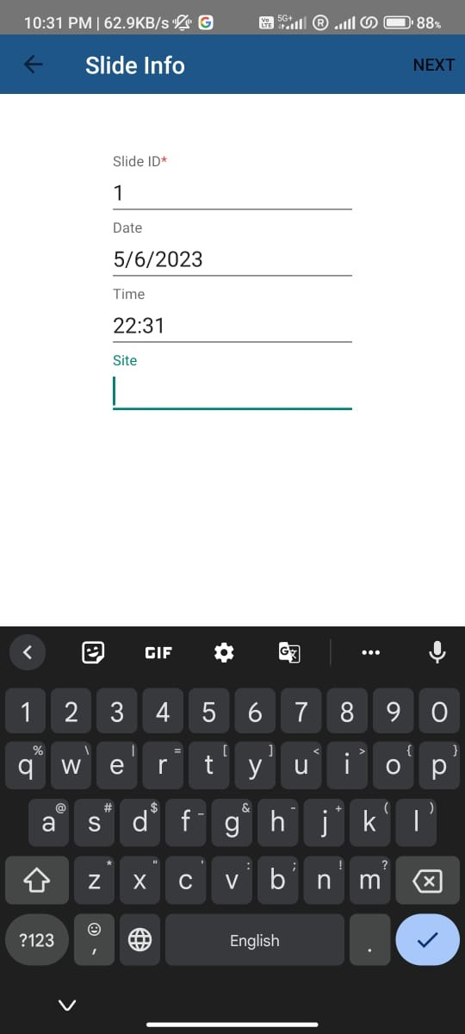
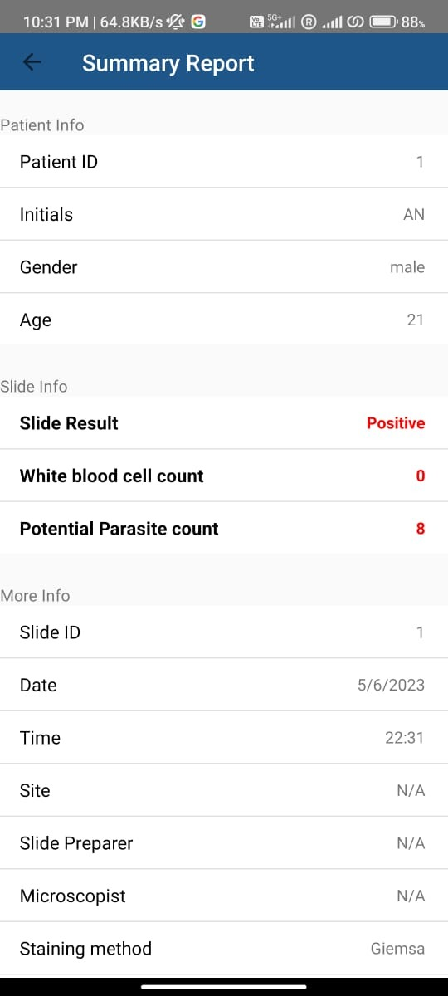
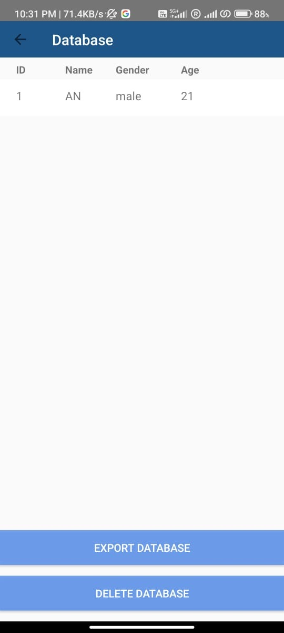
SCREENSHOTS
PATIENT INFO
SLIDE INFO
SUMMARY INFO
DATABASE

Slide 10
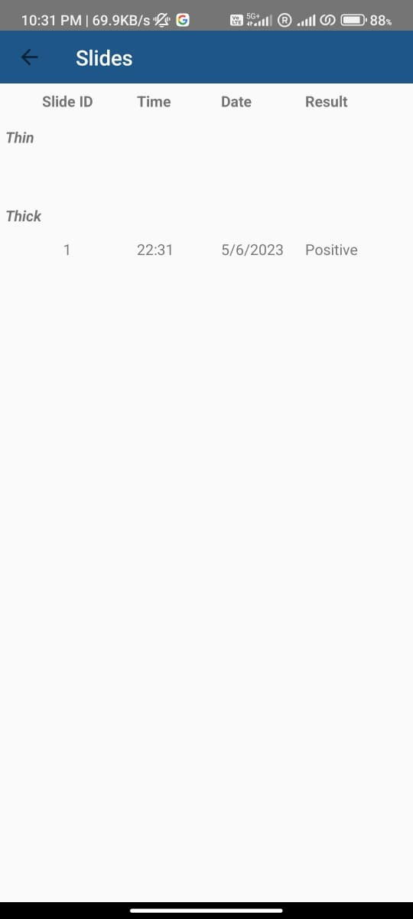
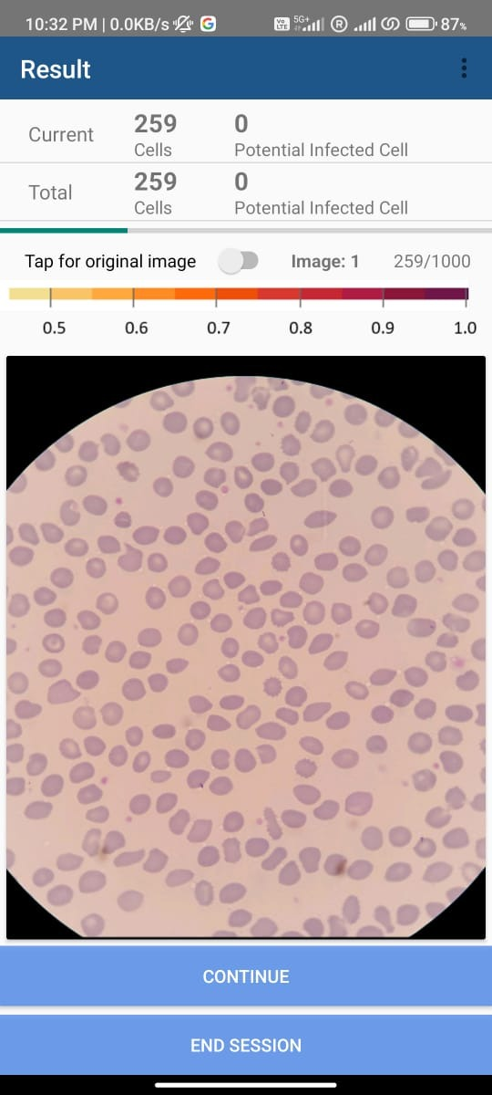
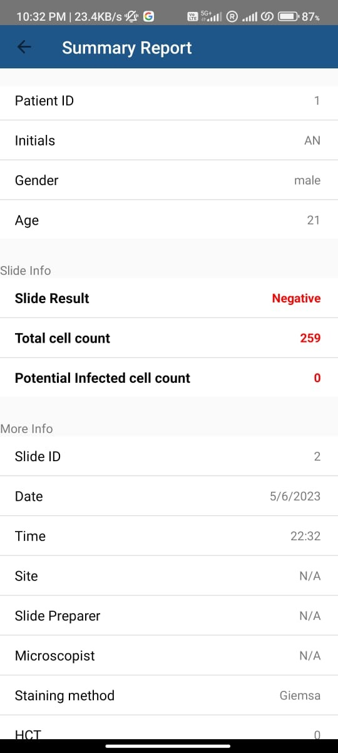
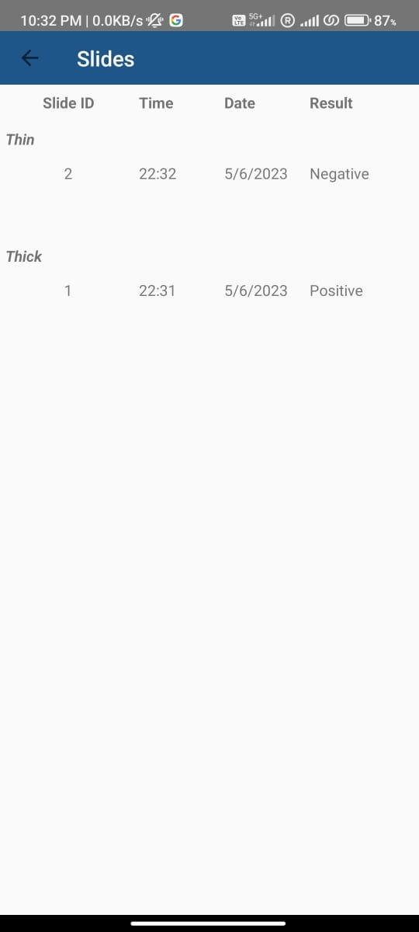
SCREENSHOTS
SLIDES
RESULT
SUMMARY REPORT
SLIDES

Slide 11
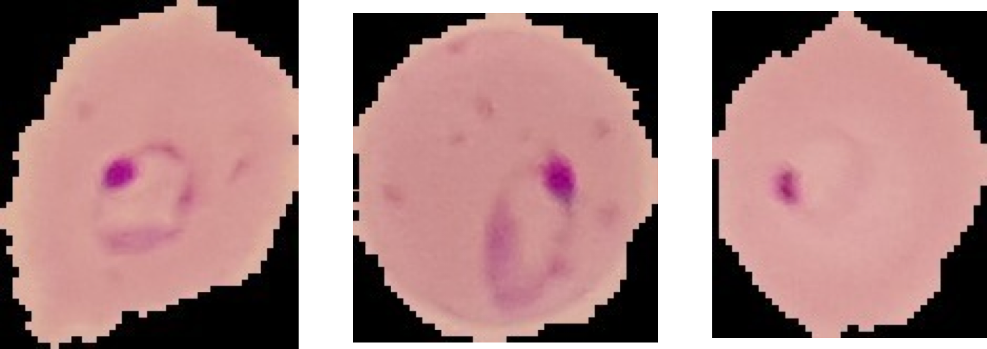
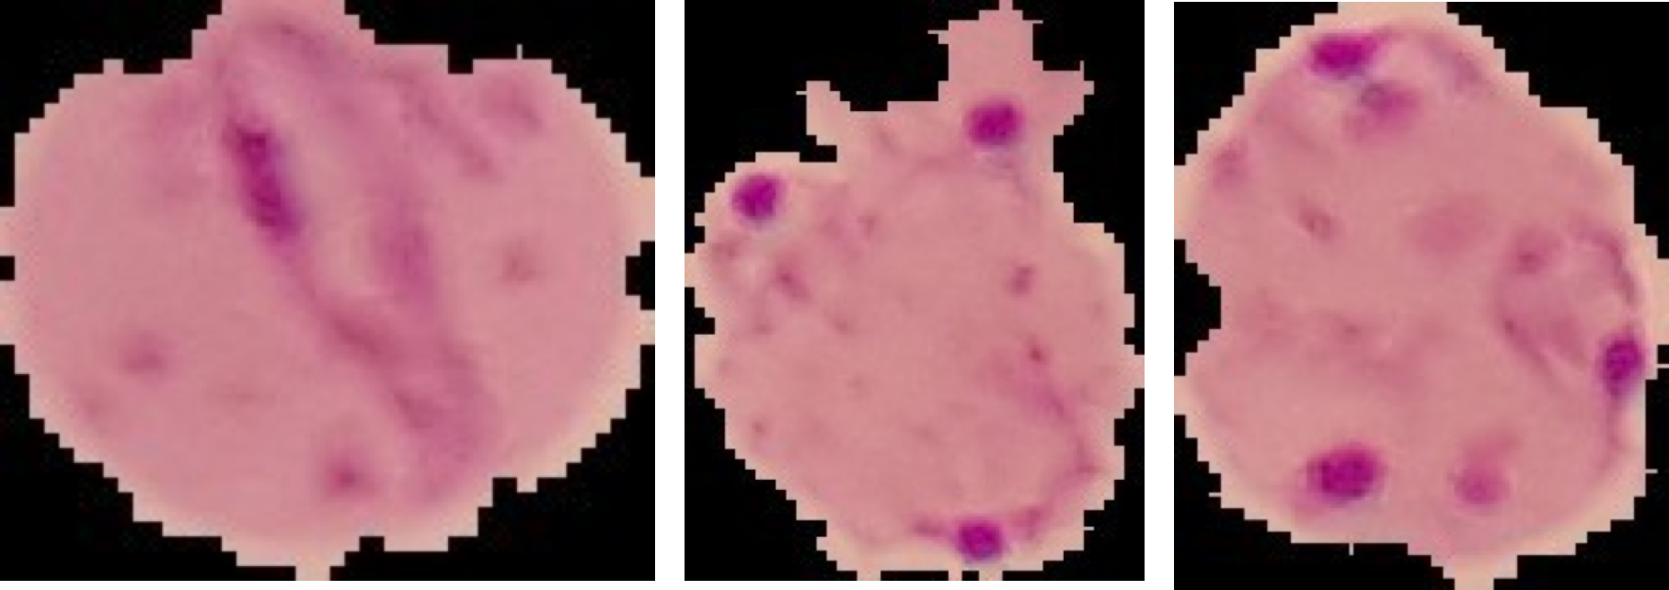
TRACKING THE PROGRESSION
RING STAGE | SCHIZONT ADVANCED STAGE
Initial Stage of the infection
Final Stage of the infection
Our model can detect if the blood sample is infected or not.
Using advance image processing techniques and self developed formulas, we can track and find out the different stages of infection.

Slide 12
TRACKING THE PROGRESSION
Detection of Malaria in Blood Cell Using Convolution Neural Network
100 samples were taken as test sample images among which 57 belong to initial ring state and the remaining 43 belong to schizont stage, the results can be observed in the following table:
BLOOD SAMPLE | AVERAGE AREA OF BLOOD SAMPLE | AVERAGE AREA OF PARASITE
PARASITE IN INITIAL STAGE | 11786 | 444.167
PARASITE IN SCHIZONT STAGE | 17617.2 | 1409
So, according to these test cases we concluded that if the area of the parasite is greater than 8% of the total area of the blood sample it’s in the advanced schizont stage else it is in the initial ring stage.
*Images were manually annotated, and the findings are based on our research.

Slide 13
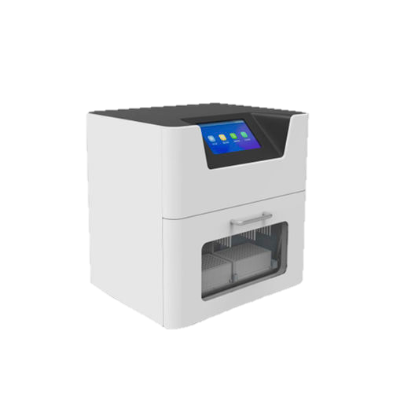
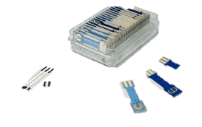
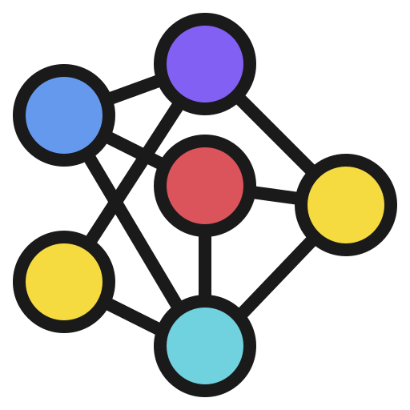
why Our approach?
DNA diagnostic machine
Electrochemical biosensors
Svm and Traditional ML
More expensive
Needs external power source
Bulky and around 500-600 grams in weight
A flaw could potentially arise in the device's accuracy and reliability in detecting nucleic acids, which could lead to incorrect diagnoses and potentially harmful treatment.
Requires training and proper guidance hence chances of human error.
Integrated electrochemical sensor and microfluidics
Highly complex and complicated system design
High cost
need to solve the poor signal stability and slow electrode kinetics.
Slow results and slower diagnosis of the disease
SVM is less efficient than CNN and OpenCV.
Lesser image in each class
Prototype alternative to microscope needs to be purchased or built.
They use Otsu threshold method whereas we use Confidence method.
The Otsu method finds a threshold that maximizes the variance between two classes of pixels, whereas the confidence method assigns a confidence value to each pixel representing the probability of belonging to the foreground class.

Slide 14
CONCLUSION
We have successfully implemented a real time web application and android application to detect malaria.
Based on our algorithm implemented to our application one can easily detect if they’re infected with malaria-parasite.
We tested our mobile application and now can distinguish between different blood cells and parasite.
The mobile app can be used as an aid to primary diagnostic method which can help in speedy detection of disease.

Slide 15
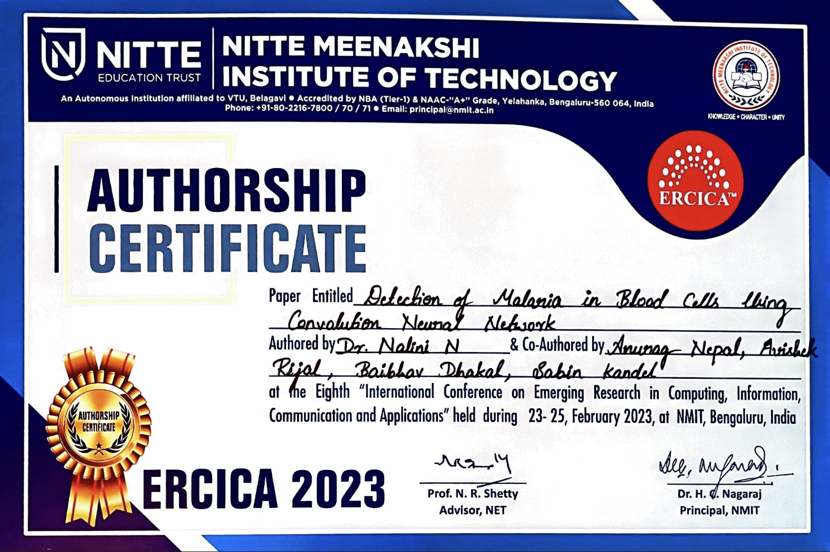
Paper published

Slide 16
THANK YOU

